Slide 1
طراحی الگوریتم
28 و 30 مهر 98
ملکی مجد

Slide 2
Topic | Reference
Recursion and Backtracking | Ch.1 and Ch.2 JeffE
Dynamic Programming | Ch.3 JeffE and Ch.15 CLRS
Greedy Algorithms | Ch.4 JeffE and Ch.16 CLRS
Amortized Analysis | Ch.17 CLRS
Elementary Graph algorithms | Ch.6 JeffE and Ch.22 CLRS
Minimum Spanning Trees | Ch.7 JeffE and Ch.23 CLRS
Single-Source Shortest Paths | Ch.8 JeffE and Ch.24 CLRS
All-Pairs Shortest Paths | Ch.9 JeffE and Ch.25 CLRS
Maximum Flow | Ch.10 JeffE and Ch.26 CLRS
String Matching | Ch.32 CLRS
NP-Completeness | Ch.12 JeffE and Ch.34 CLRS

Slide 3
Talk about graph
DFS
BFS

Slide 4
Running time of a graph algorithm
the size of the input of the graph
the number of vertices |V|
and the number of edges |E|
Inside asymptotic notation (such as O-notation or Θ-notation)
the symbol V denotes |V| and the symbol E denotes |E|
the pseudocode views vertex and edge sets as attributes of a graph
denote the vertex set of a graph G by V[G] and its edge set by E[G]

Slide 5
Two representations of graphs
Either way is applicable to both directed and undirected graphs
as adjacency lists
provides a compact way to represent sparse graph($|E|$ is much less than ${|V|}^{2}$)
Assumed by most of the presented graph algorithms in this course
as adjacency matrices
the graph is dense($|E|$ is close to ${|V|}^{2}$)
or when we need to be able to tell quickly if there is an edge connecting two given vertices
Rather than using one word of computer memory for each matrix entry, the adjacency matrix uses only one bit per entry.

Slide 6
Example of undirected graph
Two representations of an undirected graph in next slide.
An undirected graph G having five vertices and seven edges.
An adjacency-list representation of G.
consists of an array Adj of |V| lists, one for each vertex in V.
For each u ∈ V, the adjacency list Adj[u] contains all the vertices v such that there is an edge (u, v) ∈ E.
The vertices in each adjacency list are typically stored in an arbitrary order
The adjacency-matrix representation of G.

Slide 7
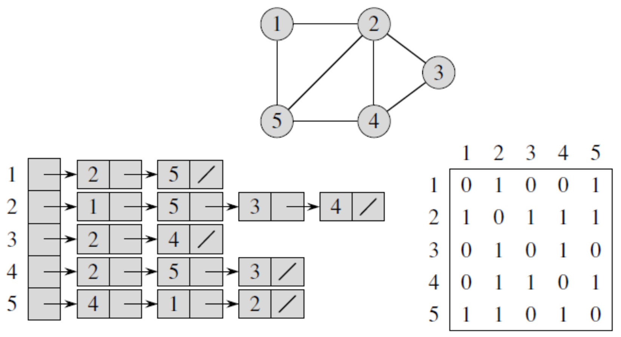
Notes:
Two representations of an undirected graph. (a) An undirected graph G having five
vertices and seven edges. (b) An adjacency-list representation of G. (c) The adjacency-matrix representation
of G.

Slide 8
Example of directed graph
Two representations of a directed graph in next slide.
A directed graph $G$ having six vertices and eight edges.
An adjacency-list representation of $G$.
The adjacency-matrix representation of $G$.
For both directed and undirected graphs, the adjacency-list representation has the desirable property that the amount of memory it requires is $Θ(V + E)$.

Slide 9
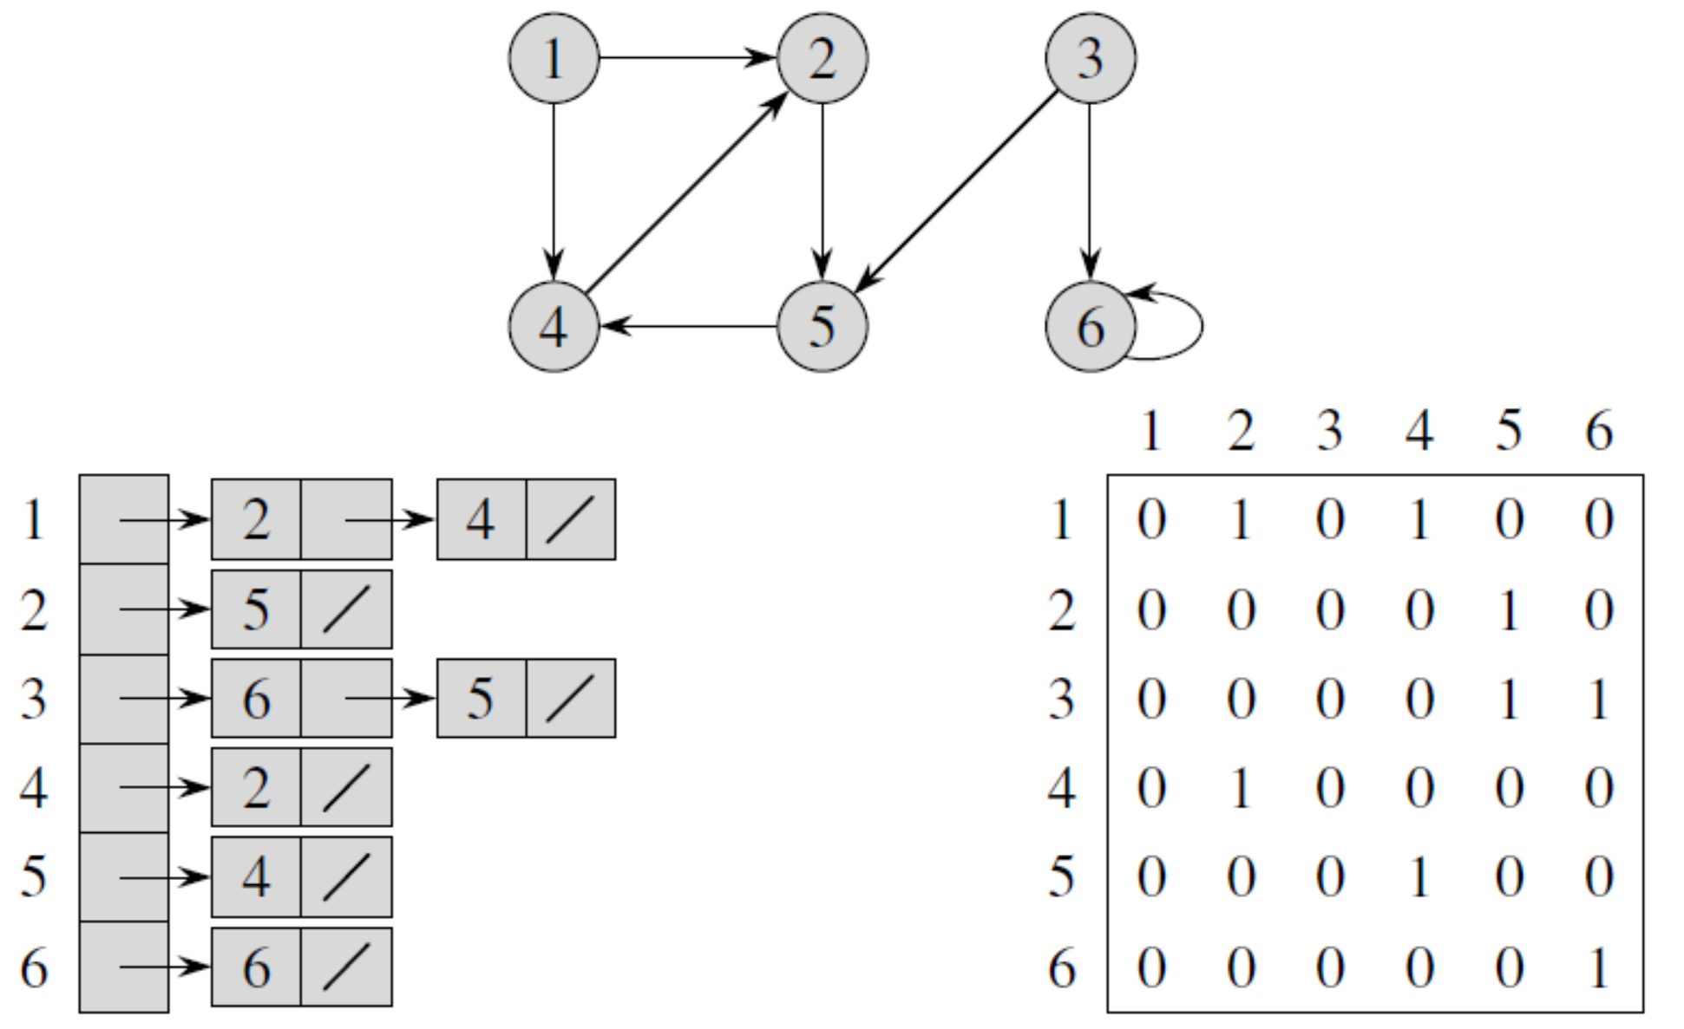
Notes:
Two representations of a directed graph. (a) A directed graph G having six vertices
and eight edges. (b) An adjacency-list representation of G. (c) The adjacency-matrix representation
of G.

Slide 10
the sum of the lengths of all the adjacency lists
directed graph : $|E|$
undirected graph : $2|E|$
the amount of memory adjacency-list representation requires
$Θ(V+E$)
the amount of memory adjacency-matrix representation requires
$Θ(V^{2}$)
independent of the number of edges in the graph

Slide 11
Transpose of a matrix A
the transpose of a matrix $A = (a_{ij})$is the matrix $A^{T}=(a_{ij}^{T})$ given by $a_{ij}^{T}$ =$a_{ji}$
the adjacency matrix A of an undirected graph is its own transpose

Slide 12
Weighted graphs
let $G = (V, E)$be a weighted graph with weight function $w :E→R$.
The weight $w(u, v)$of the edge $(u, v) ∈ E$ is simply stored with vertex $v$ in $u$’s adjacency list
the weight $w(u, v)$ of the edge $(u, v) ∈ E$ is simply stored as the entry in row $u$ and column $v$ of the adjacency matrix

Slide 13
درجه خروجی راس های یک گراف جهت دار را در چه زمانی می توانیم حساب کنیم؟
درجه ورودی راس های یک گراف جهت دار را در چه زمانی می توانیم حساب کنیم؟
زمان مورد نیاز برای پیدا کردن گره universal sink چقدر است (گراف با ماتریس مجاورت نمایش داده شده)؟
(گره ای با درجه خروجی $\left|V\right|−1$ و درجه ورودی صفر)
در زمان$O\left(V\right)$ می شود؟

Slide 14
Breadth-first search
one of the simplest algorithms for searching a graph
archetype for many important graph algorithms
Prim
Dijkstra,
breadth-first search systematically explores the edges of $G$ to “discover” every vertex that is reachable from $s$
It computes the distance (smallest number of edges) from $s$ to each reachable vertex
produces a “breadth-first tree” with root $s$ that contains all reachable vertices
for any vertex $v$ reachable from s, the path in the breadth-first tree from $s$ to $v$ corresponds to a “shortest path” from $s$ to $v$ in $G$

Slide 15
Breadth
the algorithm discovers all vertices at distance $k$ from $s$ before discovering any vertices at distance $k + 1$

Slide 16
To keep track of progress, breadth-first search colors each vertex white, gray, or black.
All vertices start out white and may later become gray and then black.
A vertex is discovered the first time it is encountered during the search
at which time it becomes nonwhite
all vertices adjacent to black vertices have been discovered
Gray vertices may have some adjacent white vertices

Slide 17
Breadth-first search
constructs a breadth-first tree,
initially containing only its root, which is the source vertex s.
Whenever a white vertex v is discovered in the course of scanning the adjacency list of an already discovered vertex $u$, the vertex $v$ and the edge$(u, v)$ are added to the tree.
$u$ is the predecessor or parent of $v$ in the breadth-first tree.
Since a vertex is discovered at most once, it has at most one parent.
Ancestor and descendant relationships in the breadth-first tree are defined relative to the root $s$

Slide 18
The breadth-first-search procedure BFS uses adjacency lists
The color of each vertex $u ∈ V$ is stored in the variable $color[u]$
The predecessor of $u$ is stored in the variable $π[u]$.
If $u$ has no predecessor (root and not discovered), then $π\left[u\right]= NIL$
The distance from the source $s$ to vertex $u$ computed by the algorithm is stored in $d[u]$.
The algorithm also uses a first-in, first-out queue $Q$ to manage the set of gray vertices

Slide 19
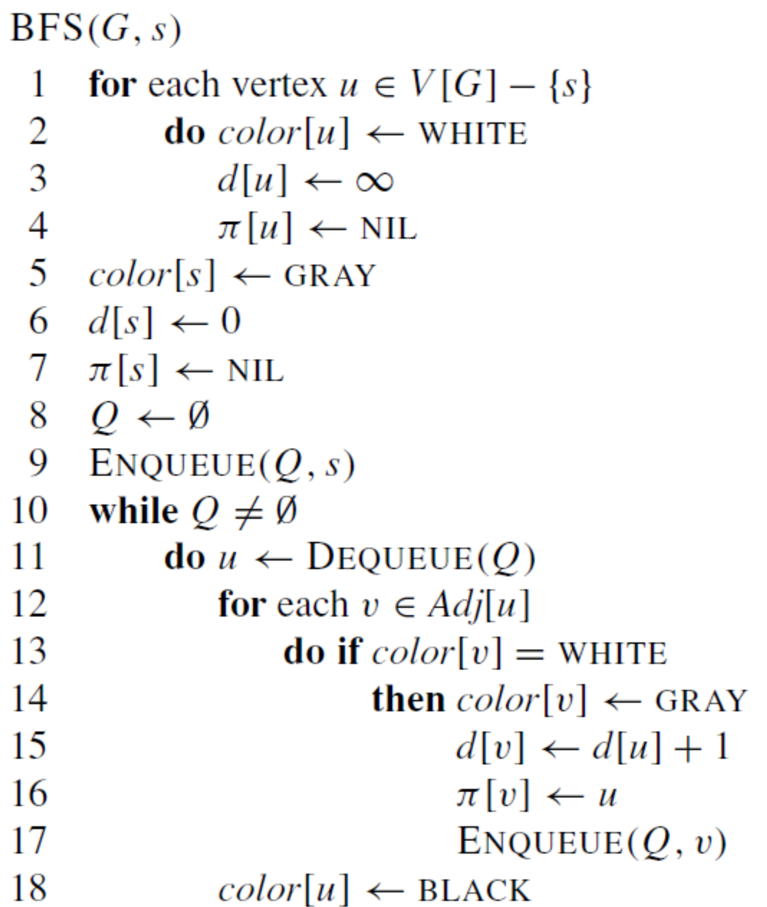

Slide 20
Compute BFS tree?
Notes:
روی تخته نوشته شود

Slide 21
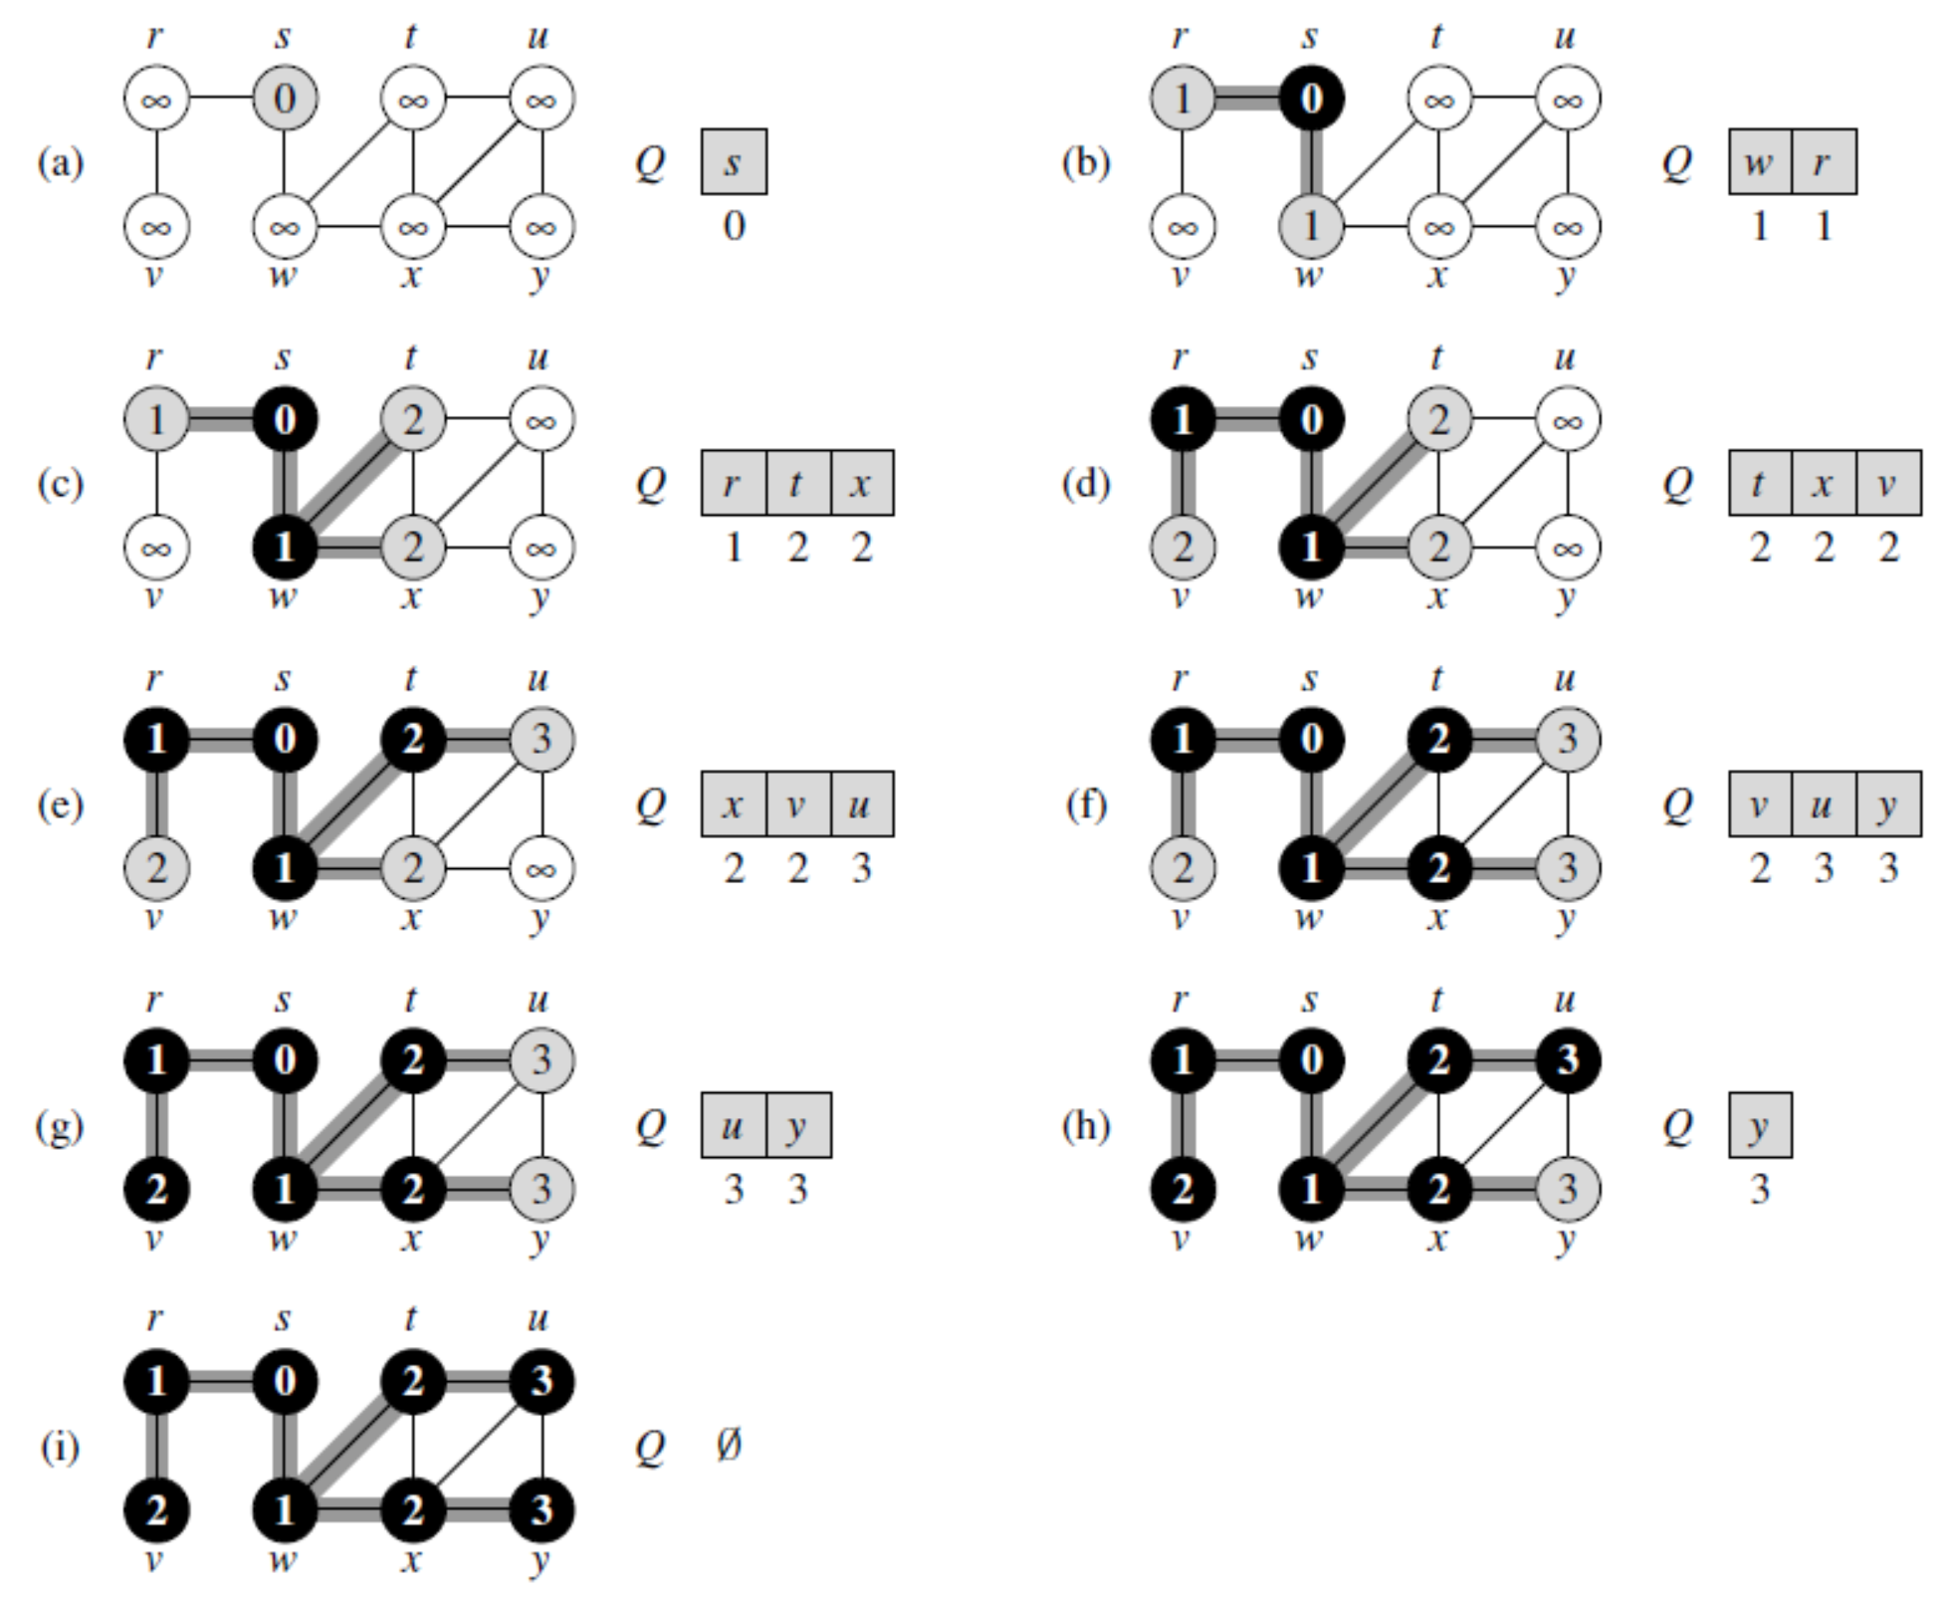

Slide 22
Result:

Slide 23
The results of breadth-first search may depend upon the order in which the neighbors of a given vertex are visited in line 12
the breadth-first tree may vary, but the distances $d$ computed by the algorithm will not vary

Slide 24
Analyzing the running time of BFS
The overhead for initialization is $O(V)$
Each vertex is enqueued at most once
and hence dequeued at most once
The operations of enqueuing and dequeuing take $O(1)$ time
the total time devoted to queue operations is O(V).
Each adjacency list is scanned at most once
sum of the lengths of all the adjacency lists is $Θ(E)$,
The total running time of BFS is O(V + E)
runs in time linear in the size of the adjacency-list representation

Slide 25
Shortest paths
we claimed that breadth-first search finds the distance to each reachable vertex in a graph $G = (V, E)$ from a given source vertex $s ∈ V$.
Define the shortest-path distance $δ(s, v)$from $s$ to $v$ as the minimum number of edges in any path from vertex $s$ to vertex $v$
if there is no path from $s$ to $v$, then $δ(s, v)=∞$.
A path of length $δ(s, v)$ from $s$ to $v$ is said to be a shortest path from $s$ to $v$.

Slide 26
Lemma 1
Let $G = (V, E)$ be a directed or undirected graph, and let $s ∈ V$be an arbitrary vertex. Then, for any edge $(u, v) ∈ E$,
$δ(s, v) ≤ δ(s, u) + 1$.
Proof: $u$ is reachable from $s$?
$u$ is not reachable from $s$?

Slide 27
We want to show that BFS properly computes $d[v] = δ(s, v)$ for each vertex $v ∈ V$. We first show that $d[v]$ bounds $δ(s, v)$ from above

Slide 28
Lemma 2
Let $G = (V, E)$ be a directed or undirected graph, and suppose that BFS is run on $G$ from a given source vertex $s ∈ V$. Then upon termination, for each vertex $v ∈ V$, the value $d[v]$ computed by BFS satisfies $d[v] ≥ δ(s, v)$.
Proof: induction on the number of ENQUEUE operations
basis : d[v] ≥ δ(s, v) for all v ∈ V (d[s] = 0 = δ(s, s) and d[v] =∞≥δ(s, v) for all v ∈ V − {s}.)
inductive step :

Slide 29
Lemma 2
Proof: induction on the number of ENQUEUE operations
inductive step :
consider a white vertex $v$ that is discovered during the search from a vertex $u$
inductive hypothesis implies that $d[u] ≥ δ(s, u)$
from lemma 1 and line 15:
$$d\left[v\right]= d\left[u\right]+ 1 ≥ δ\left(s, u\right)+ 1 ≥ δ\left(s, v\right)$$
$d[v]$ never changes again (because never enqueued again)

Slide 30
To prove that $d[v] = δ(s, v)$, we must first show more precisely how the queue $Q$ operates during the course of BFS.
The next lemma shows that at all times, there are at most two distinct $d$ values in the queue.

Slide 31
Lemma 3
Suppose that during the execution of BFS on a graph $G = (V, E)$, the queue Q contains the vertices$v_{1},v_{2}, . . . , v_{r}$ , where $v_{1}$ is the head of Q and $v_{r}$ is the tail.
Then,
$d[v_{r}] ≤ d[v_{1}] + 1$ and
$d[v_{i}] ≤ d[v_{i+1}]$ for $i = 1, 2, . . . , r − 1$.
Proof: induction on the number of queue operations

Slide 32
Lemma 3
Proof: induction on the number of queue operations
basis : Initially, when the queue contains only $s$, the lemma certainly holds.
inductive step : we must prove that the lemma holds after both dequeuing and enqueuing a vertex.
Notes:
If the head v1 of the queue is dequeued, v2 becomes the
new head. (If the queue becomes empty, then the lemma holds vacuously.) By
the inductive hypothesis, d[v1] ≤ d[v2]. But then we have d[vr ] ≤ d[v1] + 1 ≤
d[v2] + 1, and the remaining inequalities are unaffected. Thus, the lemma follows
with v2 as the head.
Enqueuing a vertex requires closer examination of the code. When we enqueue a
vertex v in line 17 of BFS, it becomes vr+1. At that time, we have already removed
vertex u, whose adjacency list is currently being scanned, from the queue Q, and
by the inductive hypothesis, the new head v1 has d[v1] ≥ d[u]. Thus, d[vr+1] =
d[v] = d[u] + 1 ≤ d[v1] + 1. From the inductive hypothesis, we also have
d[vr ] ≤ d[u] + 1, and so d[vr ] ≤ d[u] + 1 = d[v] = d[vr+1], and the remaining
inequalities are unaffected. Thus, the lemma follows when v is enqueued.

Slide 33
Corollary 4
Suppose that vertices $v_{i}$ and $v_{j}$ are enqueued during the execution of BFS, and that $v_{i}$ is enqueued before $v_{j}$. Then${ d[v}_{i}]≤d[v_{j}$] at the time that $v_{j}$ is enqueued.
Proof:
Lemma 3
Each vertex receives a finite $d$ value at most once during the algorithm

Slide 34
Theorem 5 (Correctness of breadth-first search)
Let $G = (V, E)$ be a directed or undirected graph, and suppose that BFS is run on $G$ from a given source vertex $s ∈ V$. Then, during its execution, BFS discovers every vertex $v ∈ V$ that is reachable from the source $s$, and upon termination, $d[v] = δ(s, v)$ for all $v ∈ V$. Moreover, for any vertex $v∈s$ that is reachable from $s$, one of the shortest paths from $s$ to $v$ is a shortest path from $s$ to π[v] followed by the edge $(π[v], v)$.
Proof: contradiction
A vertex receives a d value not equal to its shortest path distance!

Slide 35
Breadth-first trees
$V_{π} = \{v ∈ V : π[v] = NIL\} ∪ \{s\}$
$E_{π}= \{(π[v], v) : v ∈V_{π}− \{s\}\}$
The predecessor subgraph $G_{π}$ is a breadth-first tree if $V_{π}$ consists of the vertices reachable from $s$ and, for all $v ∈V_{π}$, there is a unique simple path from $s$ to $v$ in $G_{π}$ that is also a shortest path from $s$ to $v$ in $G$.

Slide 36
Lemma 6
When applied to a directed or undirected graph $G = (V, E),$ procedure BFS constructs $π$ so that the predecessor subgraph${ G}_{π}= (V_{π},E_{π})$ is a breadth-first tree.

Slide 38
DFS

Slide 39
depth-first search
to search deeper in the graph whenever possible
Two applications of depth-first search
Sorting a directed acyclic graph (DAG)
Finding the strongly connected components of a directed graph

Slide 40
Insight of DFS
In depth-first search,
edges are explored out of the most recently discovered vertex $v$ that still has unexplored edges leaving it.
When all of $v’$s edges have been explored, the search backtracks to explore edges leaving the vertex from which $v$ was discovered (predecessor)
This process continues until we have discovered all the vertices that are reachable from the original source vertex.
If any undiscovered vertices remain, then one of them is selected as a new source and the search is repeated from that source.

Slide 41
From one vertex

Slide 42
coloring technique
Each vertex is initially white, is grayed when it is discovered in the search, and is blackened when it is finished
This technique guarantees that each vertex ends up in exactly one depth-first tree

Slide 43
timestamps
Each vertex v has two timestamps:
the first timestamp d[v] records when v is first discovered (and grayed),
and the second timestamp f [v] records when the search finishes examining v’s adjacency list (and blackens v)
These timestamps are integers between 1 and 2 |V|
Notes:
Vertex u is WHITE before time d[u], GRAY between time d[u] and time f [u], and BLACK thereafter.
These timestamps are used in many graph algorithms and are generally helpful in reasoning about the
behavior of depth-first search.

Slide 44
the predecessor subgraph produced by a depth-first search may be composed of several trees
search may be repeated from multiple sources

Slide 45
Whole graph

